Slide 1

LANE LINE DETECTION
PHAM TIEN THANH
DAO ANH THANH
LY TRUNG KIEN
NGUYEN TUAN HUNG

Slide 2

LANE LINE DETECTION What’s the main idea?
Why is Lane Line Detection?
The Algorithm used in this project
Future Deployment
Possible Outcome

Slide 3

LANE LINE DETECTION
Why is Lane Line Detection?

Slide 4

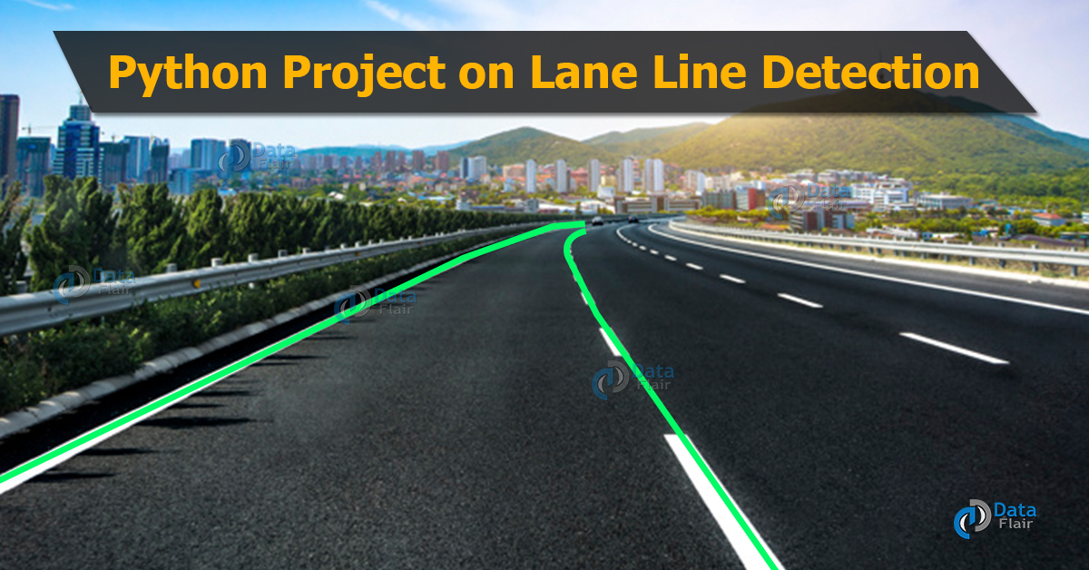
LANE LINE DETECTION Why is Lane Line Detection?
Improving self-driven car
Decreasing traffic accidents
Collision alerting
Being a foundation of future researchers

Slide 5

LANE LINE DETECTION
The main algorithm

Slide 6
LANE LINE DETECTION The main algorithm used in this project
Curve Line Detection Algorithm
Other

Slide 7
LANE LINE DETECTION
Future Deployment

Slide 8
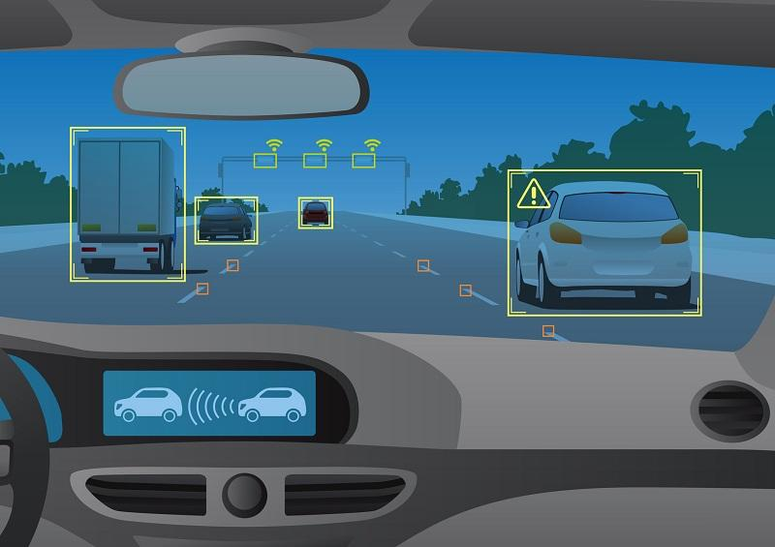
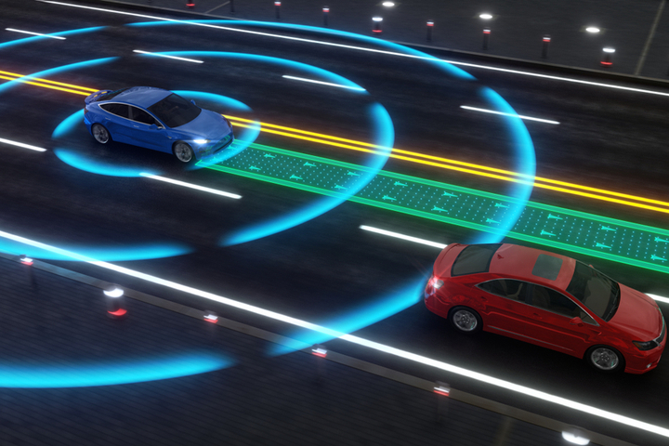
LANE LINE DETECTION Future Deployment
The project would be able to using sensor to detect objects

Slide 9
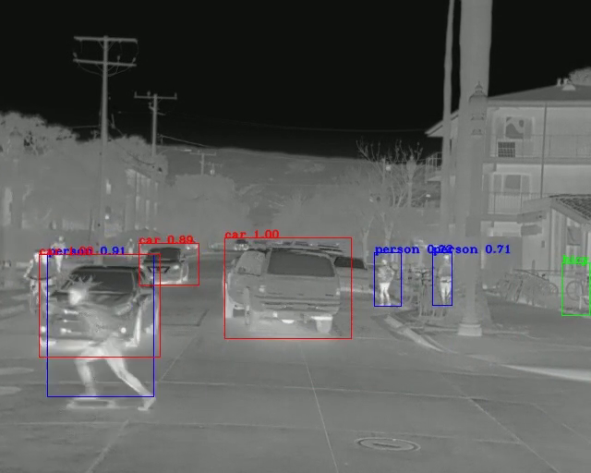
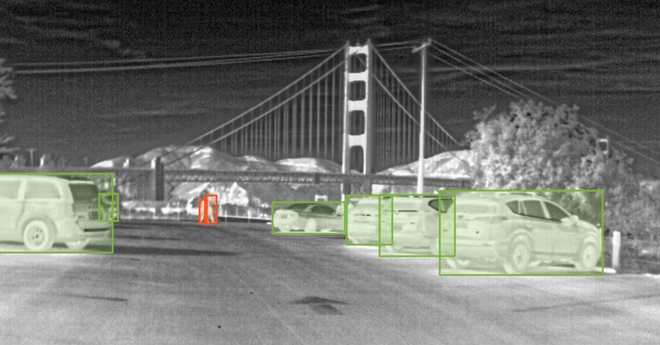
LANE LINE DETECTION Future Deployment
The project would be able to using sensor to detect objects
It could detect objects in the dark environment

Slide 10
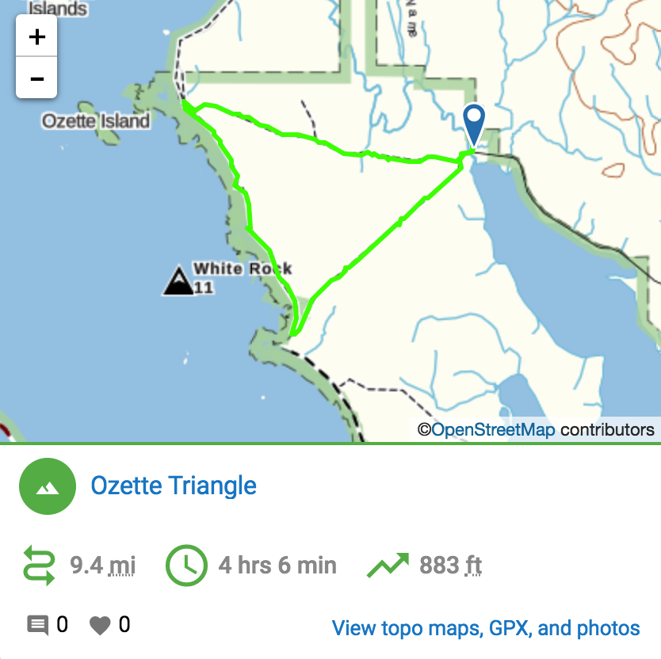
LANE LINE DETECTION Future Deployment
The project would be able to using sensor to detect objects
Using embed GPS
It could detect objects in the dark environment

Slide 11
LANE LINE DETECTION Future Deployment
The project would be able to using sensor to detect objects
Using embed GPS
It could detect objects in the dark environment
Using CLDA

Slide 12
LANE LINE DETECTION
Possible Outcome

Slide 13
LANE LINE DETECTION Why is Lane Line Detection?
Demo

Slide 14
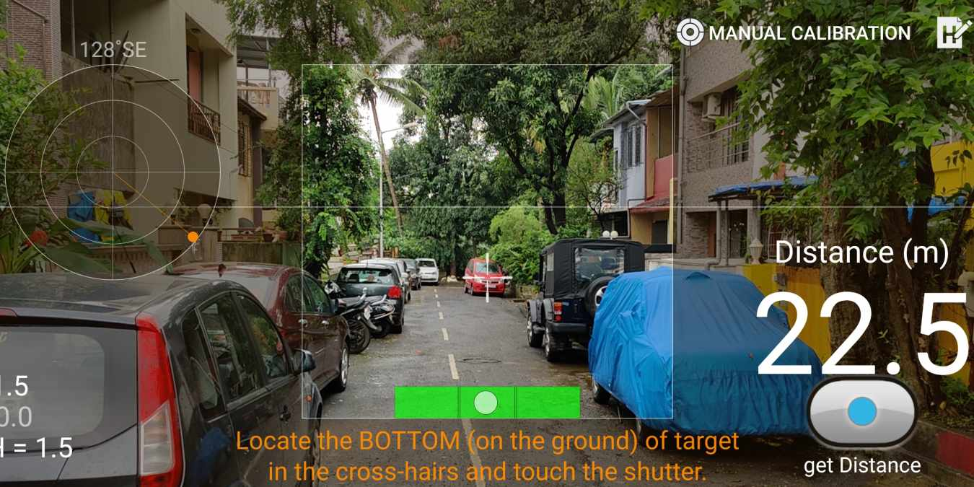
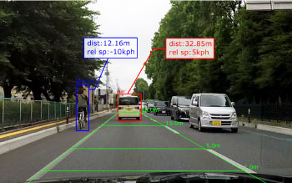
LANE LINE DETECTION Why is Lane Line Detection?
Demo
Distance Measurement

Slide 15
LANE LINE DETECTION
Thanks for listening!

